Slide 1
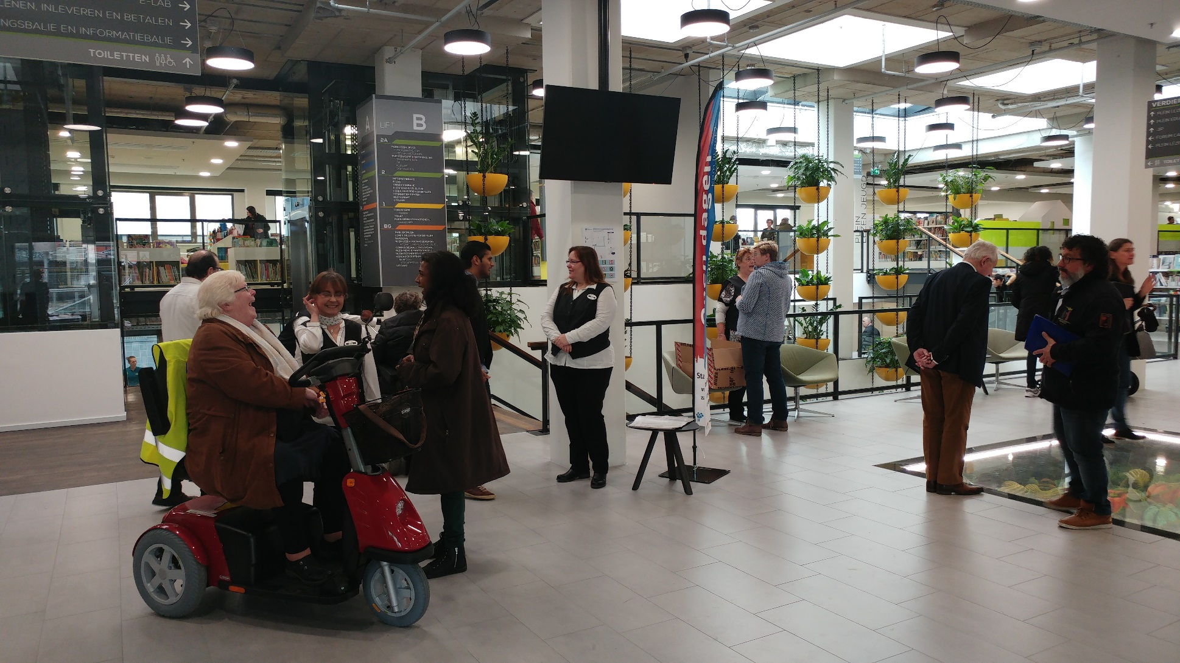
Paris, June 2019
Vers une bibliothèque participative

Slide 2
La Bibliothèque Zoetermeer
3 parties d’un même réseau:
1 bibl. centrale(Le Forum)
2 bibl. de quartier
28 bibl. scolaires
124,000 habitants
836,000 entrées par an
31,400 inscrits
Pourquoi changer?
61 employés (41 ETP)
176 bénévoles
Notes:
Introductie cijfers
Vervolg:
Five years ago, just like many libraries around the world, we faced certain challenges. The number of people using library services was, and is, steadily decreasing. We concluded that we the future would be very uncertain if we would continue on our traditional library path.
So, what could we offer people in this fast changing society, how could we stay relevant for new generations?
Naar nieuwe dia

Slide 3
Une idée émerge…
“Une bibliothèque participative: pour rassembler les gens, les orienter parmi l’information et les services ”
Notes:
We noticed that in this new society, people weren’t always better off. Illiteracy is growing again. So is loneliness. People lacking digital skills are forced to watch from the sidelines, because so many information and services, even governmental services, are only offered online.
We decided that our ideal was a ‘participation library’. An institution where everyone can engage, meet others and learn the skills they need to fully participate in society.
We couldn’t and didn’t need to make that happen all by ourselves. Many local organisations, in the areas of educational, cultural and social services, were very eager to join in. And I mean that very literally, by joining forces under the same roof and knowing enough of each others services to help all visitors find the service they need. Library Zoetermeer made this into an organized collaboration, under our direction. We call this collaboration, ánd the building in which it operates; our main branch: the Forum.
The municipalité at the time was about to build a new city hall, in which there would be a place for the library.

Slide 4
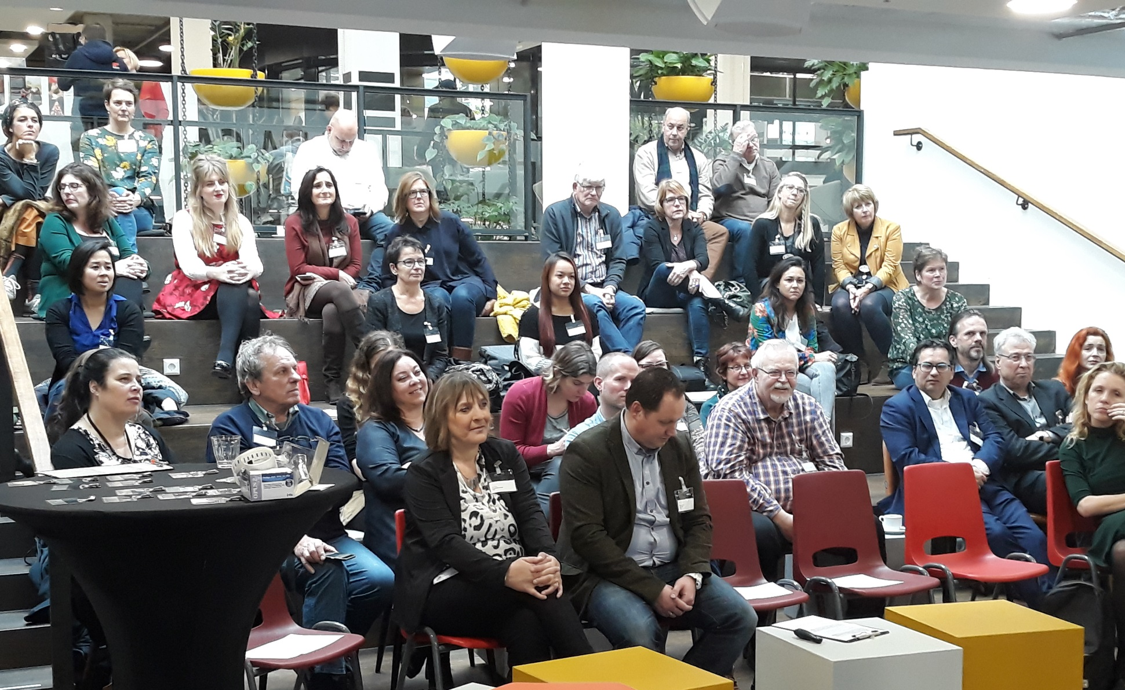
Nous avons créé le Forum
Le Forum est le site principal de la bibliothèque Zoetermeer,
‘la bibliothèque participative’
Avec
La mairie
La municipalité
Et 50 organisations locales
éducatives
sociales
culturelles
Notes:
After many negotiations, and a huge amount of designing and deciding together with the municipalité, we moved, four years later into our brand new place. The Forum and city hall, together in the same building with the 50 partners of the library: some with a desk of their own, others only for consulting hours.
A once very traditional library building was transformed into an beautiful, inspiring and hospitable place, in the centre of the city of Zoetermeer.
A place where all people are welcome. For information, support, advice and of course to have a great time.
Some of the municipalité services are integrated in the Forum, like services for the less abled, architecture, and housing. And we share back office spaces and the meeting rooms.
Video timelapse (plaatje camera)

Slide 5
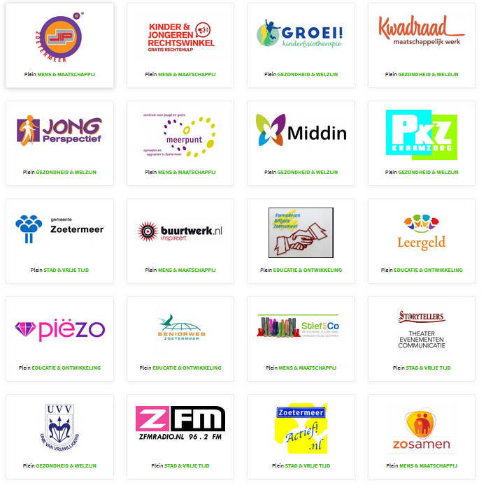
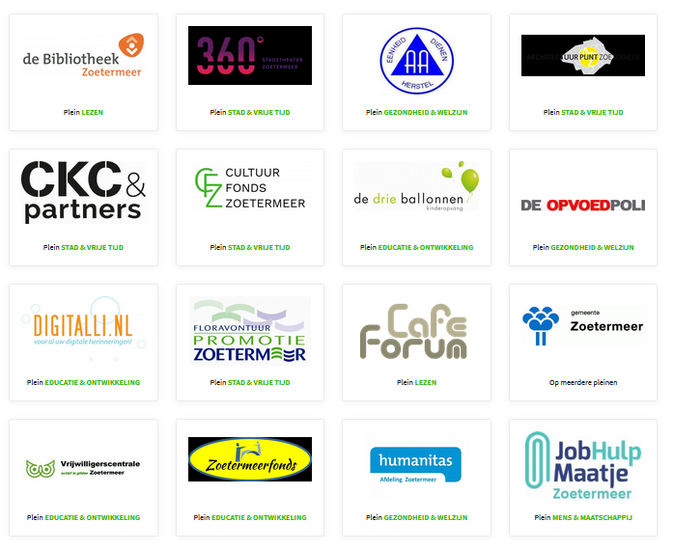
Partenaires
Notes:
These are some of our partner organisations. The number fluctuates, but we found that there are always organisations eager to participate. Many more than we anticipated all that time ago when our first ideas arose.

Slide 6
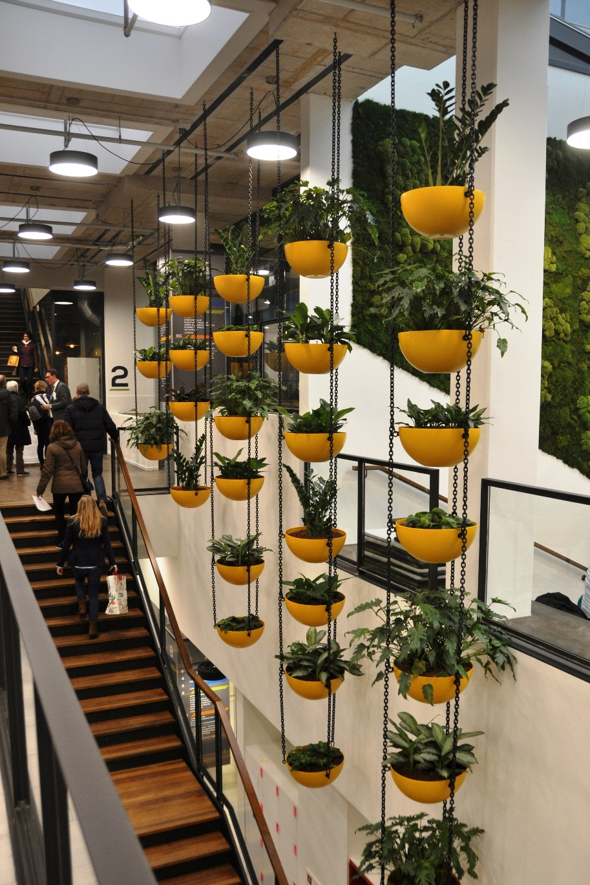
Le Forum est unique
Une vaste gamme de services : culturels, sociaux et éducatifs
Les services sont intégrés
Ouvert de 8 h à 20 h
Quels avantages pour le public de Zoetermeer?
Notes:
The Forum offers a wide range of cultural, educational and social services. It’s not just reading, or mainly education, or focused on cultural activity, or a collaboration with social services. It’s all of that. Bear with me for a moment, I will give plenty of examples later in this presentation.
The services in the Forum are integrated: this means that partner organisations are familiar with each others’ services and will equally help visitors find the service they need.
The Forum is open daily from 8 to 20 hrs, in weekend 10 to 18 hrs. These opening hours are made possible by a combination of full service and self service hours, and the help of many volunteers. During full service hours employees are present to offer all usual services. During self service hours, visitors can lend and bring back books and make use of all facilities in the building, but without the support of an employee.
So, how do the people of Zoetermeer benefit from all this? Well, they no longer have to travel all over the city to find the services they need. Instead, everything is in this one central spot in the heart of the city; one place for information, support, personal growth and inspiration.

Slide 7
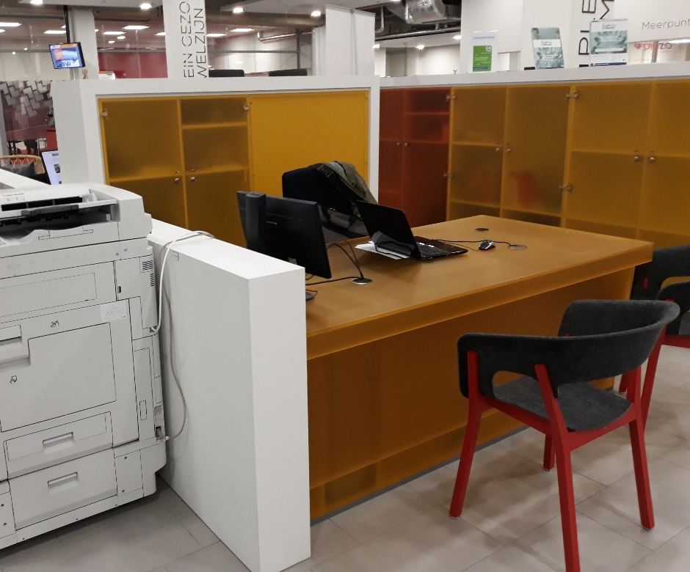
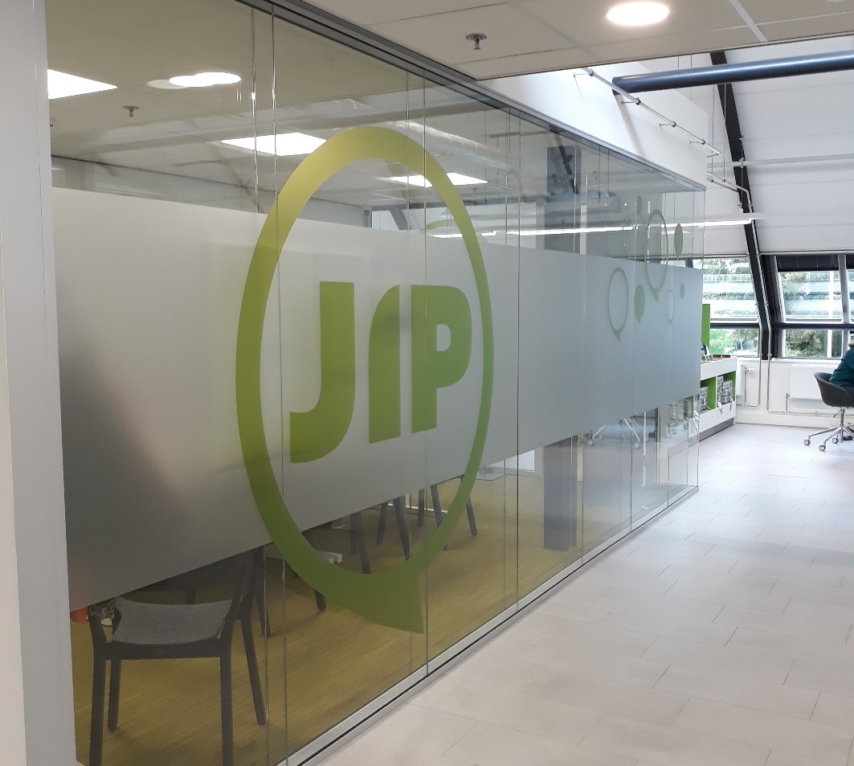
Partenaires integrés au Forum
Des espaces clos respectant l’intimité
Des comptoirs partagés pour les consultations
Un espace hybride: comptoir et espace clos
Notes:
The way the partners are spaced in the library, is the result of a careful review of their needs.
Some partners need no more than an nice, visible counter, where library visitors can meet with them and have a consulation. An example of that is an organisation that helps people dealing with everything that needs to be arranged in regard to a funeral.
Jip (Youngster Information Point) is a partner organisation that services teenagers. This is a clientèle that requires a great amount of privacy and for that reason their space is closed off and has a privacy screen on the glass panels.
Lastly, other partners need a counter as well, but will also have to have personal talks with their clients that require some privacy, and also need more office working space than a single counter can provide. For instance, an organisation like ZoSamen, loosely translated as ‘together’, that handles most of the volunteer work in Zoetermeer. Potential volunteers – or people who need the help of a volunteer - can get into first contact with them at the counter, and will be taken to the private consultation room when the discussion gets into personal details. .

Slide 8
Dans le Forum
Des zones thématiques
Un espace lecture
Un espace ville et loisirs
Un espace santé et société
Un espace éducation
Dans chaque espace: des collections thématiques
Notes:
Five squares
The Forum has five main areas – called ‘squares’ - plus a number of municipalité specific and other areas.
The library collection is integrated in the entire Forum. Yes, as you see on the screen, there is a specific ‘reading square’ with novels and children’s books, but the collection is literally everywhere. All squares showcase a good collection of informative library books about the subjects that are relevant to that specific area. So, in the City & Leasure square you can find books about theatre and hobbies. In the Health & Societal square about diseases, dieting and the raising of children, to name a few. And so on.
Reading square, as I said, this square hosts a large collection of children’s books and most of the adult novel collection.
City & leasure square, which offers insight into the past and future of Zoetermeer, architecture, exposées, hobbies, an event calendar with local events, and sports.
Health & societal square, the area where organizations offer advice and support about these subjects and organize meetings and workshops for people who suffer certain afflictions. Here, visitors can get advice and help concerning a number of subjects from raising children, to dealing with personal debt, to requesting resources like wheelchairs or domestic help. The municipalité is an important partner on this square.
Educational square, which is all about learning anything you could ever need in today’s society – digital skills, language skills, a makerspace E-Lab with 3D-printers and designing software and machines, and also ‘fun’ courses like mindfulness. Let me tell you a bit more about this educational square in particular.

Slide 9
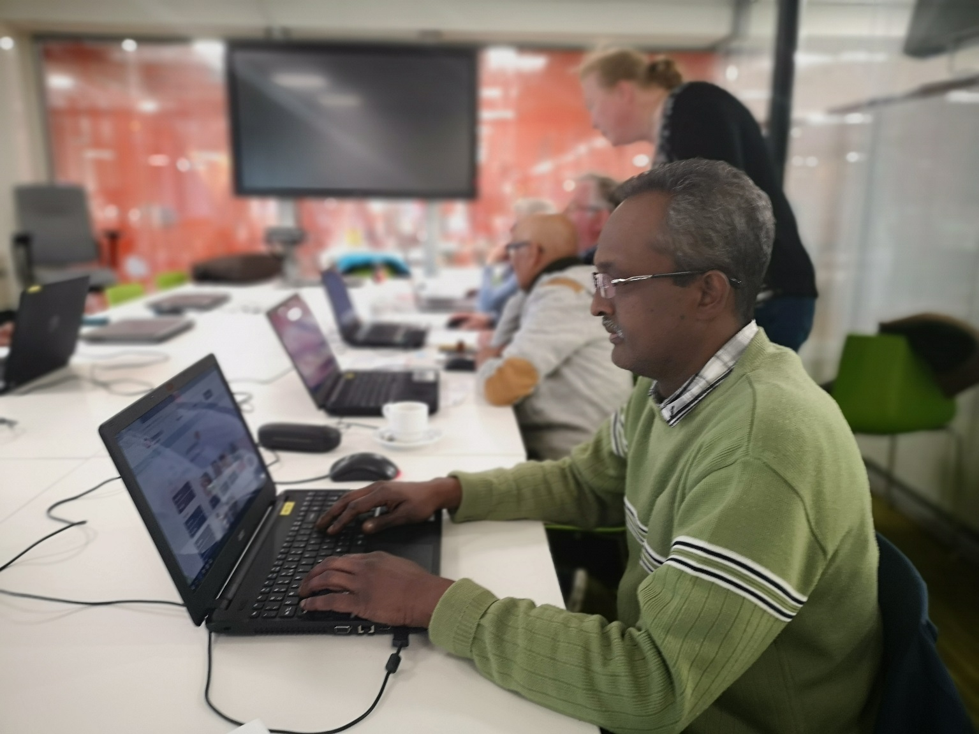
Espace éducation : Accent sur 4 aspects principaux
Compétences de base pour prendre part à la vie sociale
Compétences pour le 21e siècle
E-Lab
Université populaire
Notes:
The purpose of this square is to facilitate, stimulate and support the education of all Zoetermeer people.
Activities on this square include the E-Lab, the Digital & Language house, a budget & money-information spot, the people’s university, Tabletcafé, internships, jobfinding support, study spots and many more. This sounds like a wildly diverse array of services, but the education square focuses on 4 main areas.

Slide 10
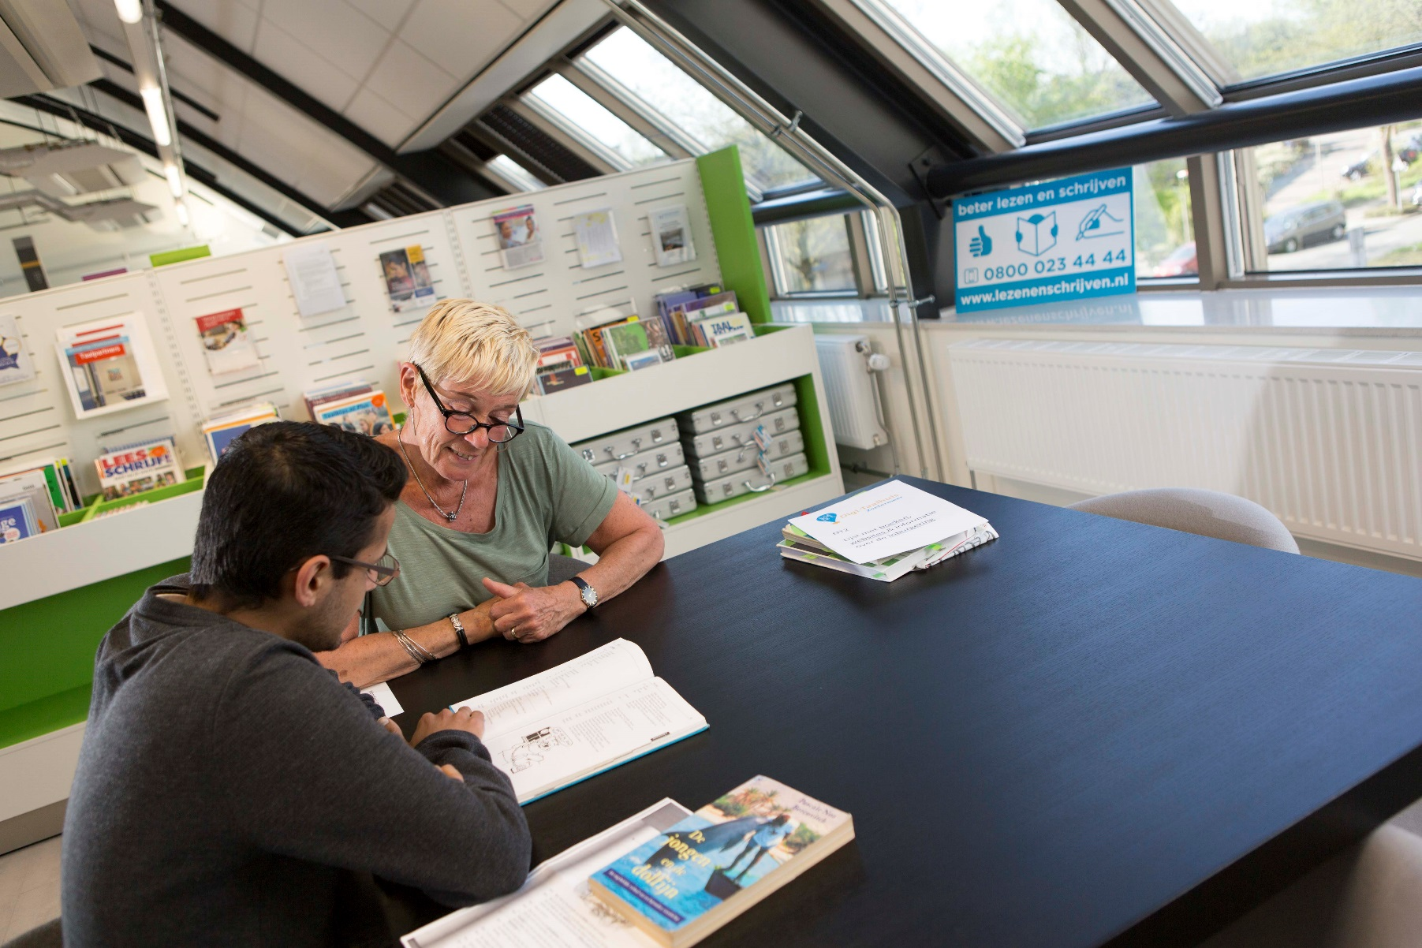
Espace éducation (1): des compétences de base pour prendre part à la vie sociale
Conversation et langue orale
Lecture et écriture élementaires
Compétences numériques: les bases
Mathématiques : les bases
‘La maison du langage et du numérique’: une coopération entre bénévoles et professionnels
Notes:
As we know, illiteracy is a problem that still exists and even today is growing again. But it’s not just about reading and writing. Newcomers in the city, mainly immigrants, have trouble understanding and speaking Dutch. This hinders them in finding jobs, applying for vital services and connecting with the local people.
And it’s also not just about language. A large number of people can’t navigate the digital highway well enough to use services they absolutely need. More and more, governmental and municipalité services are accessible only by using the internet. Finding vital information on income support or tax duties, filling out forms, but also applying for jobs to name a few things we can’t do anymore without going online.
And hey, it’s not just about digital skills either. If you can’t understand basic math, you won’t be able to control your household budget or fill in the forms you need for income support or taxes.
The Digital & Language house on the Educational square is a home base where people can learn al these skills with the help of volunteers and professional organisations. Fortunately, it’s not just about serious matters. Learning things is very much about fun too. Let me tell you more.

Slide 11
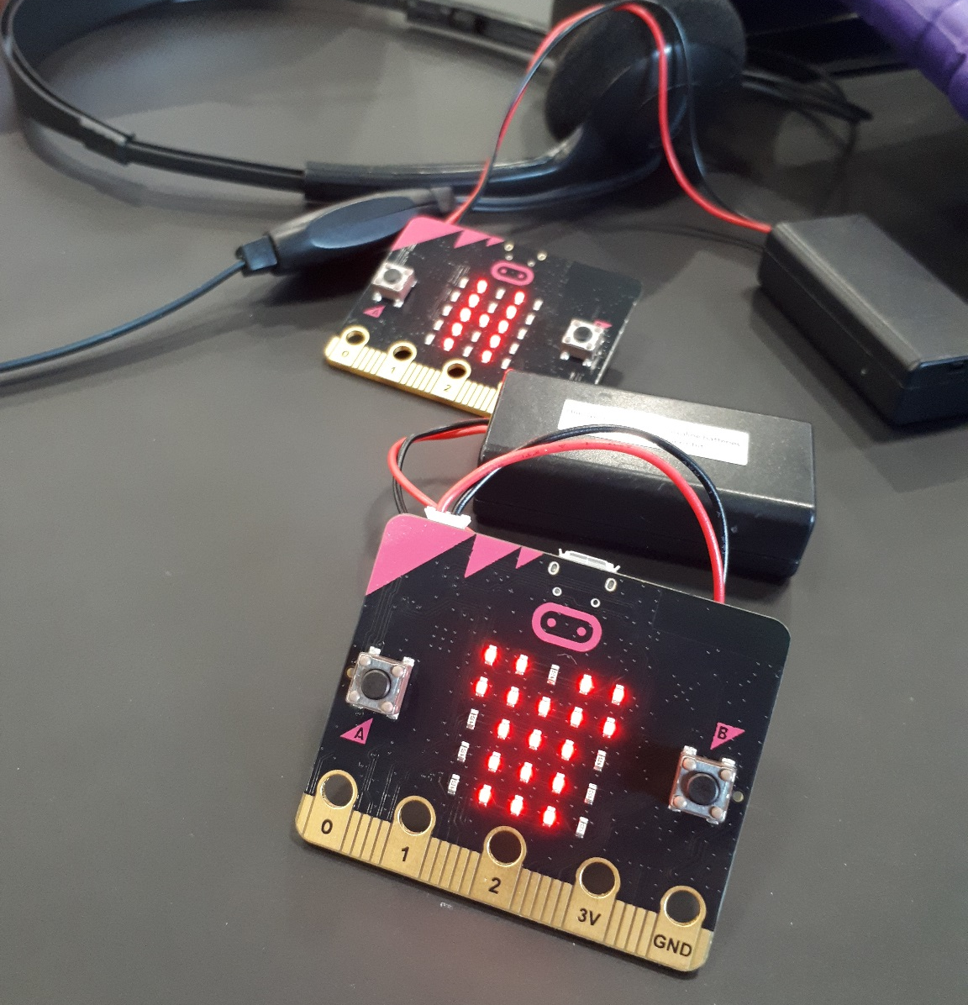
Espace éducation (2): compétences pour le 21e siècle
Littératie numérique
Compréhension des médias
Traitement de l’information
Pensée computationnelle
A la fois au Forum et dans les écoles
Des cours ludiques de programmation et de vlogging…
Notes:
We tend to think that children and young people can easily handle the information overload that comes to them through internet and smartphones. That they can find all information they need, can distinguish between useful and false information, can find and use online municipal and governmental services. That they can keep themselves safe in the world of social media and have enough common sense to understand that their euro’s are easily spent online, but not so easily earned back.
Well, unfortunately they can’t. They do know how to operate their smartphones very well and they certainly can find Wikipedia. But just like in the olden days, kids and teenagers needed to learn basic life skills like budgeting and how the government works, they now need to learn 21st century informational skills. We offer school courses, which our consultants teach in the classrooms, and workshops and courses in the Forum.
We can and make these a lot of fun, with games and polls and lots of active participation from the children. Children who want to take a next step, can learn how to code in computer languages or how to make their own video logs. Hugely popular.

Slide 12
Espace éducation (3): E-Lab
Maker space
Logiciels et machines pour créer
Bricoleurs, goûters d’anniversaire, créateurs, événements…
Gérés et animés en collaboration avec un partenaire/entrepreneur : imprimerie spécialisée dans le design graphique
Notes:
The E-Lab in the Forum is a maker space, full of intriguing machinery, computers and colourful materials. Everything in the E-Lab revolves around designing and making objects by using computerbased software and hardware.
That sounds vaguely threatening, but don’t worry. Even very young children can have fun in the E-lab by drawing plastic bunnies with 3-D pens.
Older children and adults can design and produce anything, from printed T-shirts to engraved wine glasses (I know you French people will like that), from full real estate maquettes to an action figurine of yourself with the 3D-body scanner. They can use the 3D-printer, do laser engraving, textile printing and much much more.
Participants are asked to share their new skills with others by writing a short blog on the website of the E-Lab.
Some of it is free, for the rest people pay a market rate. People can use the E-Lab individually or take part in a group workshop. People of all skill levels can use the E-Lab, you don’t have to be a technical genius.
The E-Lab is run in co-ownership with the library by one of our partners. An entrepeneur with a graphics & printshop. The machines are his, we offer space and materials for some events, and require a certain return on investment. We organize some events in the E-Lab together, while others are organized by the partner.
The particular know-how this partner offers is invaluable, since we as a library don’t have that ourselves. On the other hand, this kind of partnership asks for a great deal of deliberation.

Slide 13
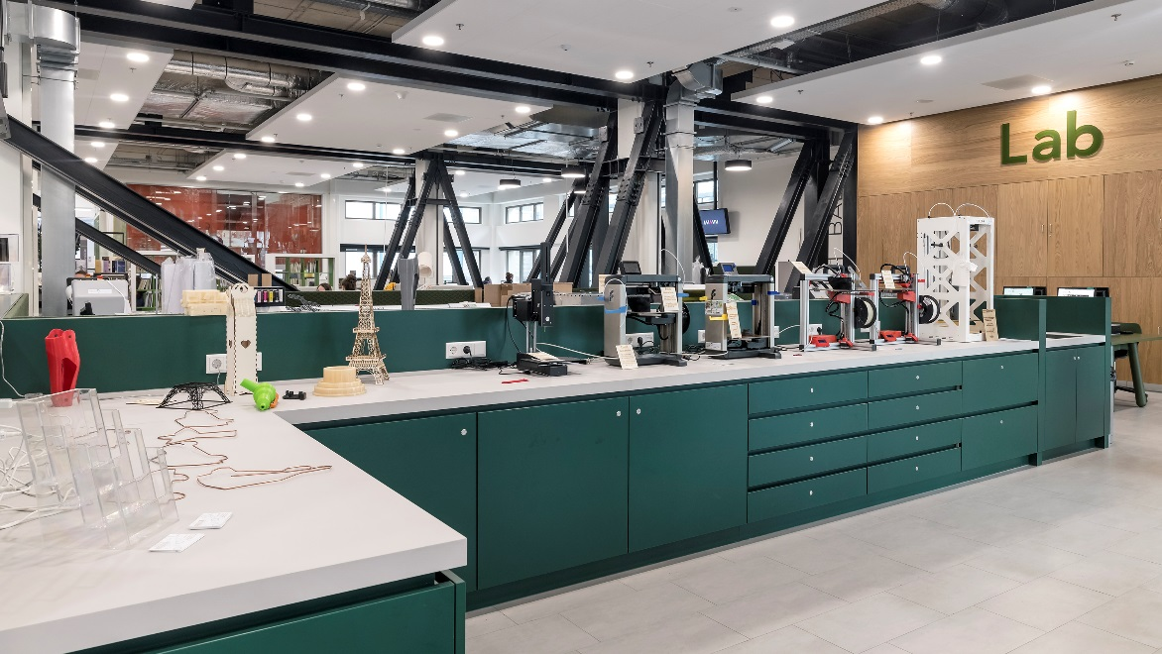
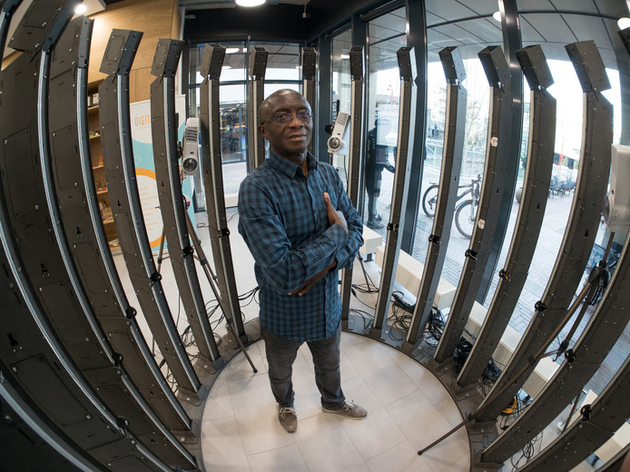
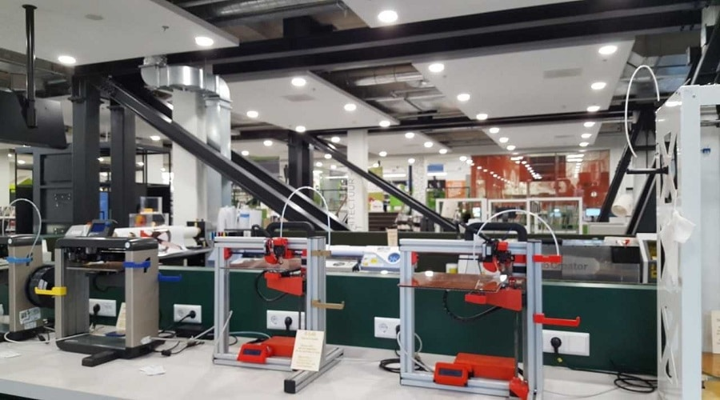
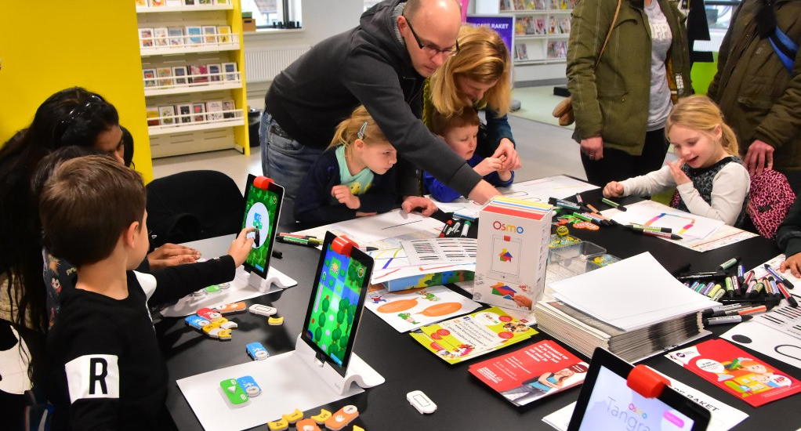

Slide 14
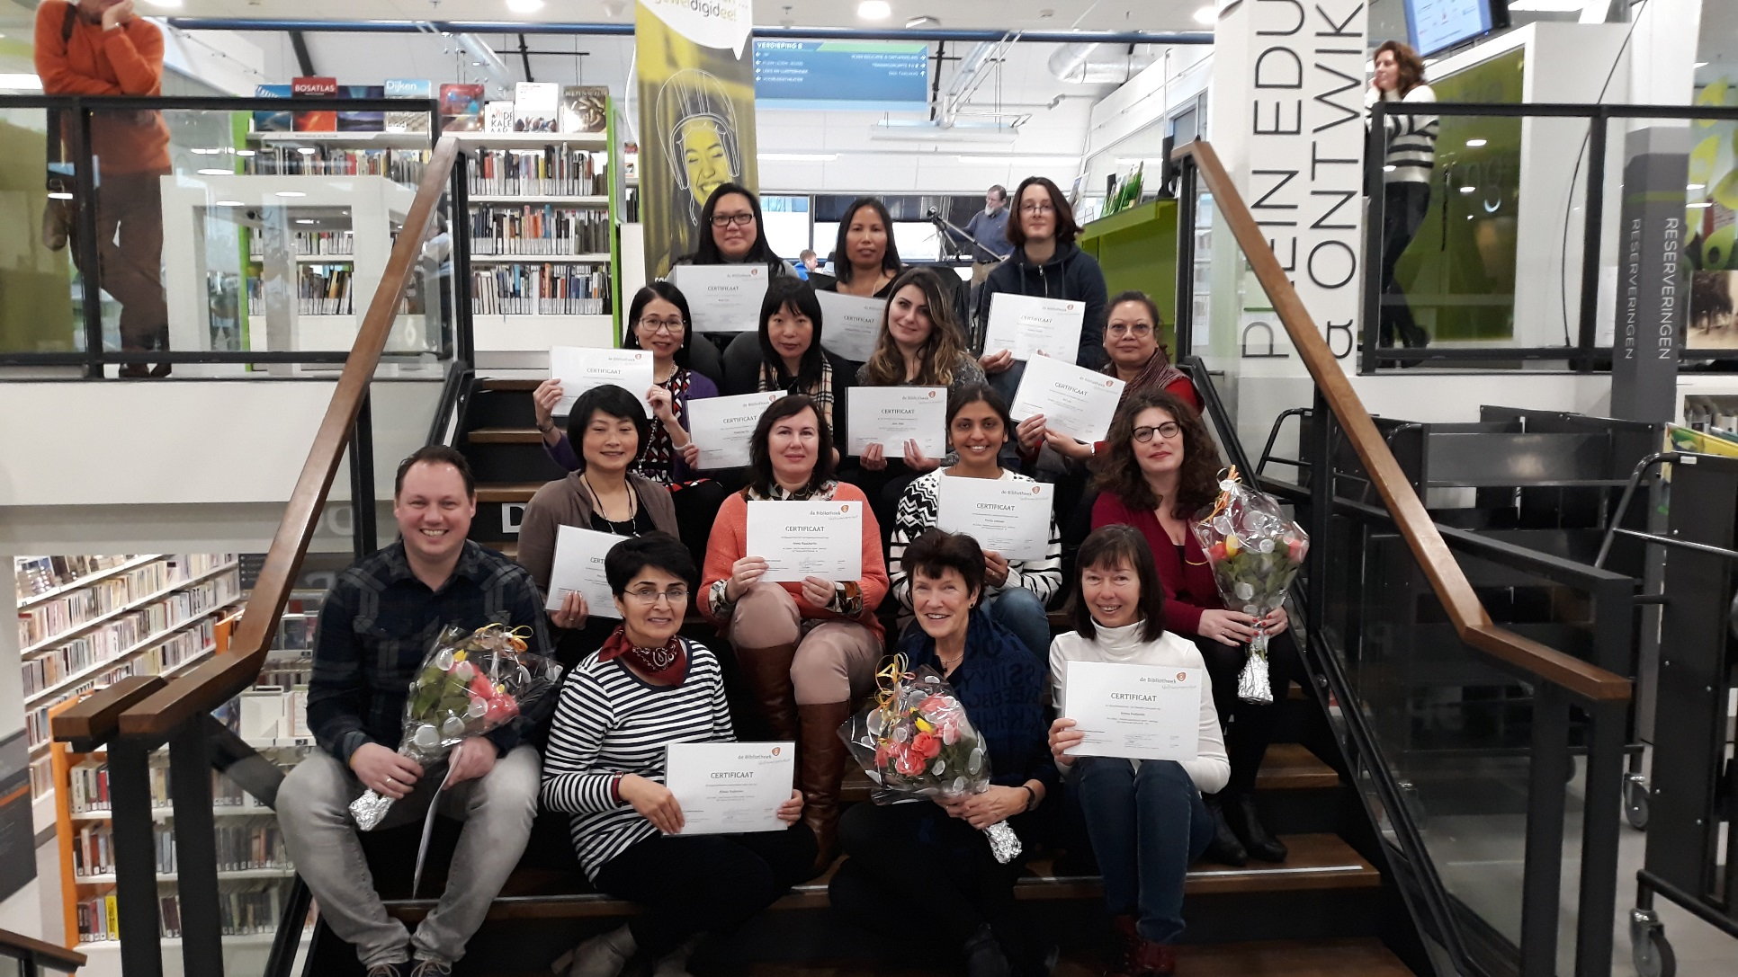
Espace éducation (4): l’Université populaire
Cours, conférences et ateliers
Langues pour voyager, culture, art, histoire, littérature, philosophie, pleine conscience, compétences de communication…
De nouveaux cours chaque année
Notes:
The People’s University, or ‘Volksuniversiteit’ in Dutch, has long been an autonomous organisation. For years it has been located in the library, until in 2016, we fully incorporated the People’s University and now it is one of our own departments, located in the Forum.
The People’s University offers a wide array of courses, lectures and workshops on all kinds of subjects. All courses are taught by certified, professional teachers.

Slide 15
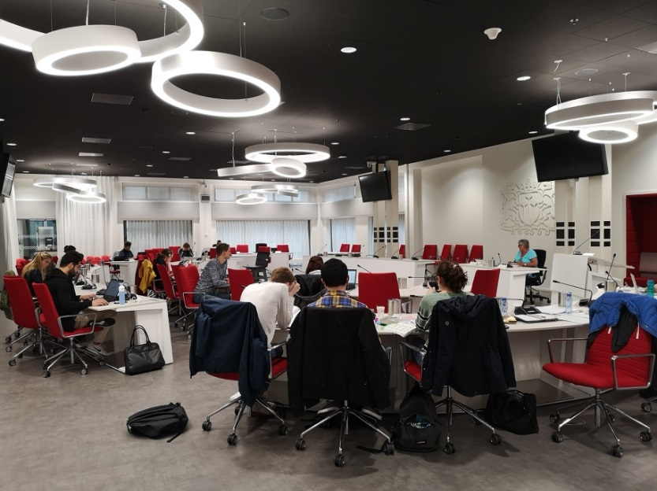
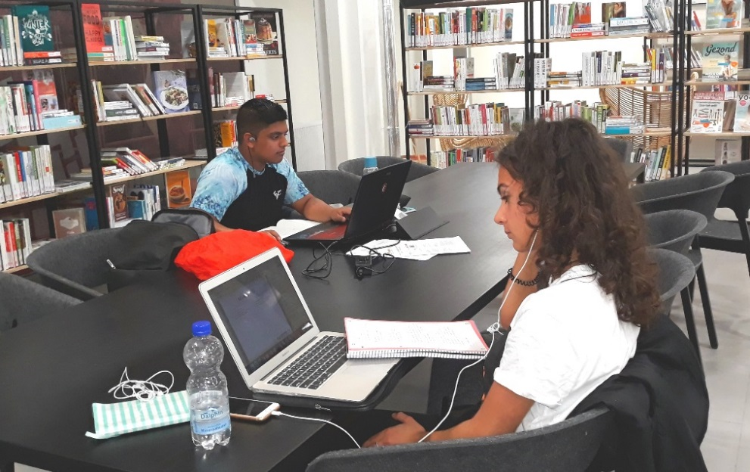
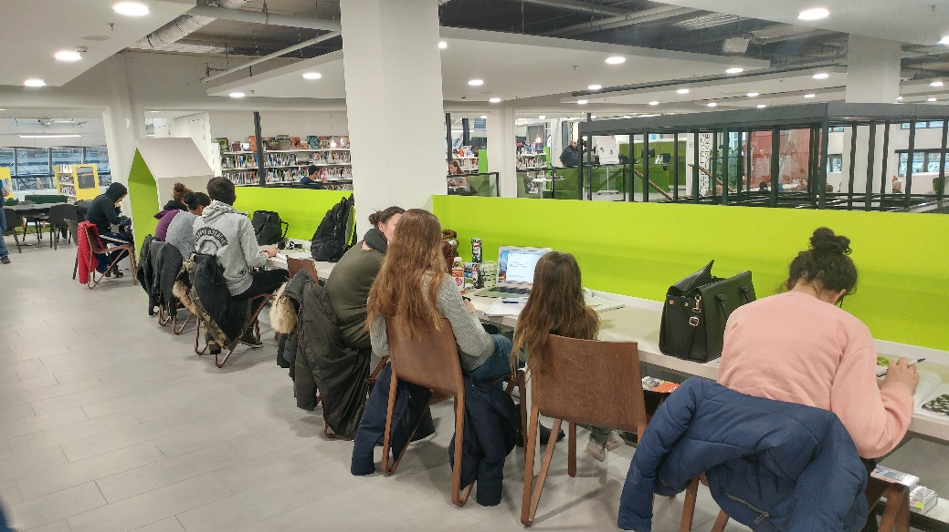
Le meilleur endroit en ville pour étudier
Notes:
Unexpectedly, the Forum became a increasingly popular spot to study. At some point even the large city hall-Forum building failed to offer enough space for all these students. At that time, we had to take measures. We agreed with the municipalité to grant the students access to the huge council room.

Slide 16
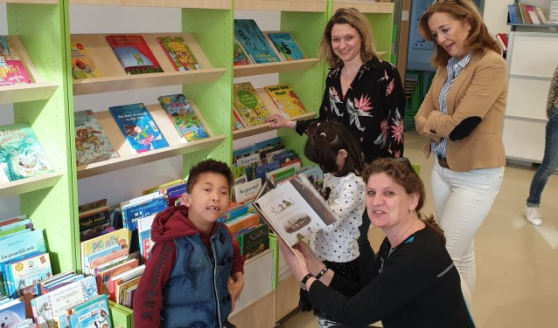
L’éducation au-delà du Forum: les bibliothèques scolaires
Livres, compétences de lecture, compétences de décryptage des média, compétences pour le 21e siècle
28 bibliothèques scolaires avec des services de conseils par des professionnels
Les résultats en lecture sont suivis et discutés avec les écoles
Les écoles s’acquittent d’un forfait par enfant
Notes:
28 school libraries: this is a vast majority of the primary schools in Zoetermeer. Also, some special schools and secondary schools have a school library.
We offer the books for the library, train the school volunteers and advice the school board and teachers. Also, we teach mediacourses and 21st century skills in the classroom. The school library collections are kept strictly up to date. Volunteers help with the daily activities in the school libraries.
Library consultants visit all schools regularly to teach courses in the classroom, to further educate the school’s own reading specialists and to go over the measured results. These results are being measured by a nationally used tool and focus on reading skills, but also on how much the children enjoy their reading activities.
Schools pay a standard fee per child for the school library and the services of the library consultants.

Slide 17
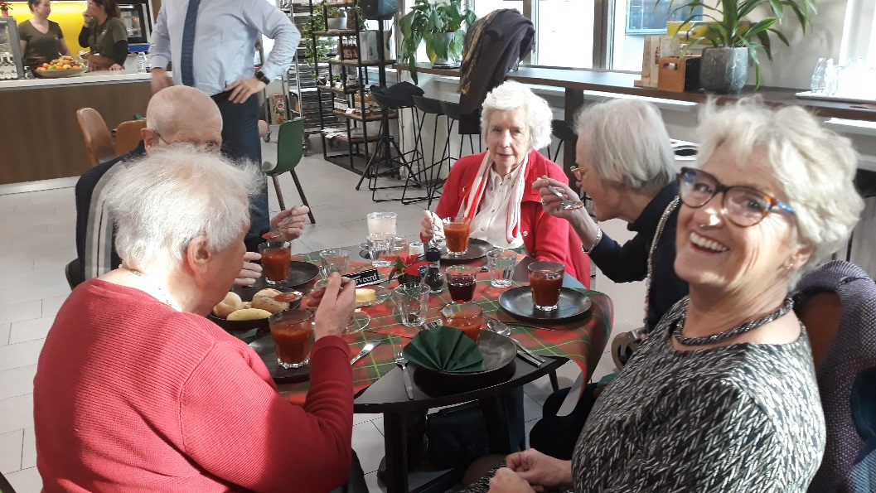
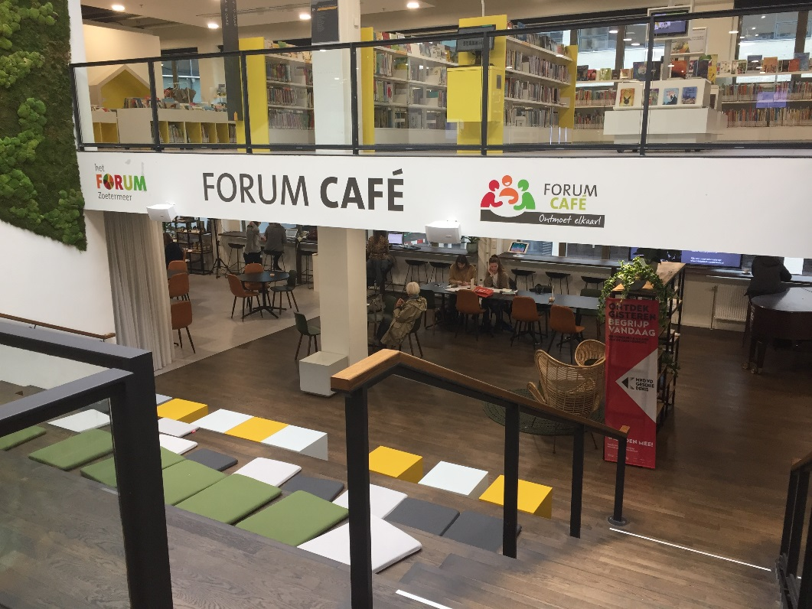
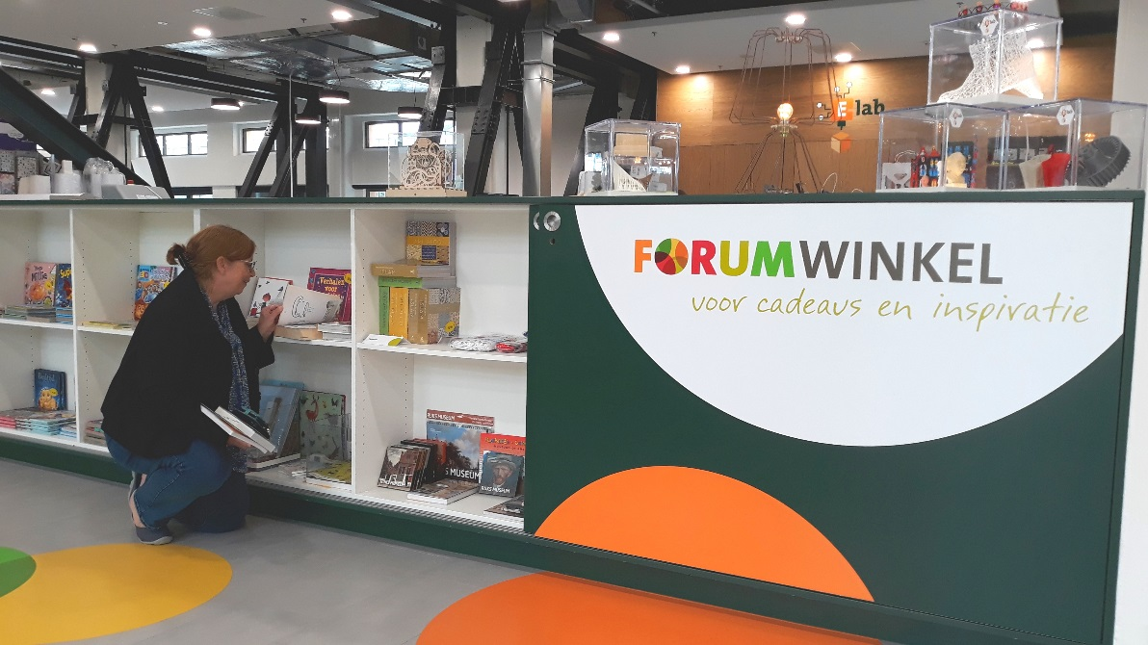
Qu’y a-t-il d’autre au Forum ?
Forum Café et une scène
Forum Shop
Notes:
Forum Café, for breakfast, lunch, snacks, pies and drinks. Mission: to challenge societal loneliness by connecting people. Under library management. Local people are encouraged to organize their own activities in The Forum Café.
Forum Shop: Only specialty goods from local suppliers
Prices range from very low to moderate
Commission based

Slide 18
Questions

