Slide 1
Libraries and social inclusion in spain
Alicia Sellés Carot
@aliciaselles
@FESABID

Slide 2
I want to talk to you about
Spanish Context
The Theory: (National Strategy about libraries and información as a framework)
The Practice (Stories and projects)
The Recognition (the seal)
Thoughts or confessions (not conclusions)

Slide 3
Context: library framework
Library Authorities in 3 levels: national, regional and local
CCB: Council of cooperation

Slide 4
Context: Libraries and development
IAP- Programe FESABID
Library and 2030 Agenda
Working Group

Slide 5
Library and social inclusion
The Theory

Slide 6
National Strategy for Information and Libraries
A multilevel working framework for library policies and services that contributes to the achievement of the national (and regional) development plan.
To get better libraries (and librarians )
to leave no-one behind (opportunities for all)
As this Startegy has been approved by the council, policy makers have got a “guide” and we (librarians) have got an advocacy tool.

Slide 7
National Strategy for Information and Libraries
The strategy proposes 4 lines of action described below:
Give visibility to libraries as a service for all citizens that contributes to personal development, social welfare and sustainable development
Guarantee access to information, culture and knowledge, guarantee library services for all people, regardless of where they live or what they need
Design library services with a 2030 Agenda perspective
Data: Remodelling, generating and exploiting data for proper analysis

Slide 8
National Strategy for Information and Libraries
Social inclusion is considered:
Line 2. Mainly focussed on the territory but in the RIGHT to Access, too.
Line 3. Mainly focussed on special collections, services and literacy and activities.

Slide 9
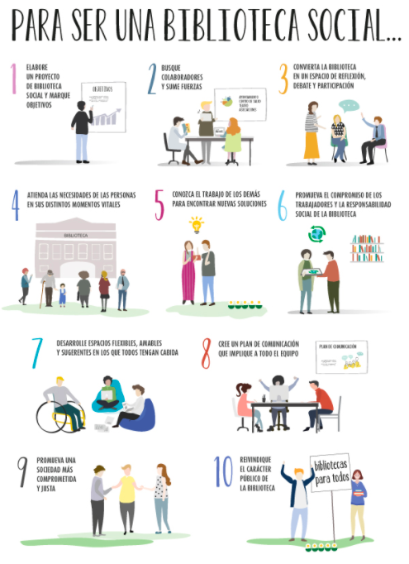
National Strategy for Information and Libraries

Slide 10
Library and social inclusion
The practice

Slide 11
Libraries working for social inclusion
Main focus areas:
Easy-to-Read /Accesibility
Migrants /multiculturality
Children and young people :
at risk of social exclusion or digital exclusion.
with long-term illnesses
unaccompanied migrant children
elderly people

Slide 12
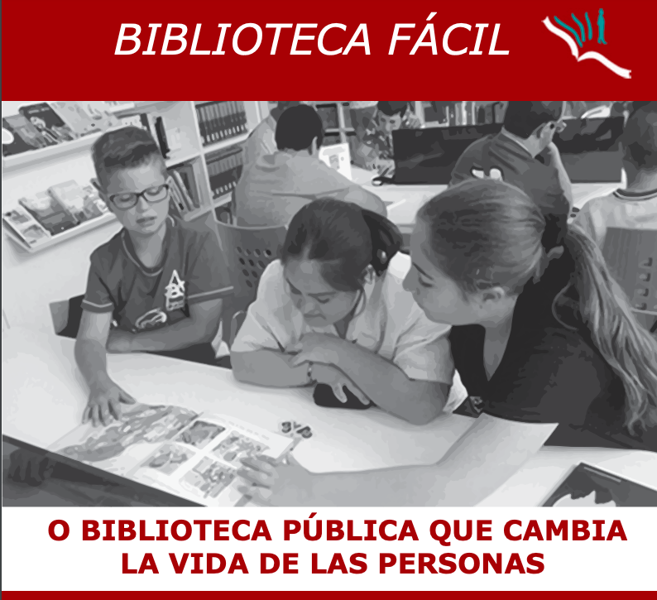
Biblioteca fácil = Easy library
Llíra, Valencia

Slide 13
Multicultural library
Gandia, Valencia

Slide 14
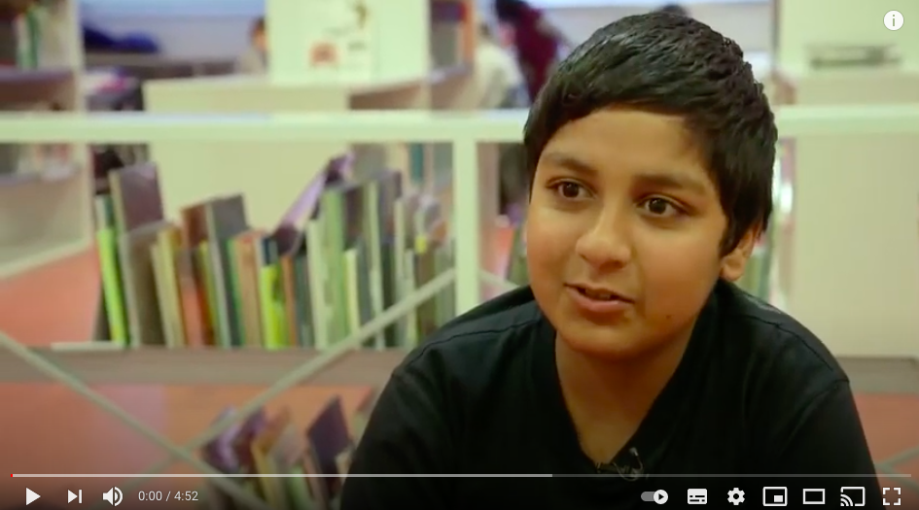
Tejiendo una red de oportunidades =Weaving a network of opportunities
Barcelona, Biblioteca Bon Pastor

Slide 15
Bibliotecas que dan vida= Libraries that bring life
Madrid, Biblioteca Eugenio Trías

Slide 16
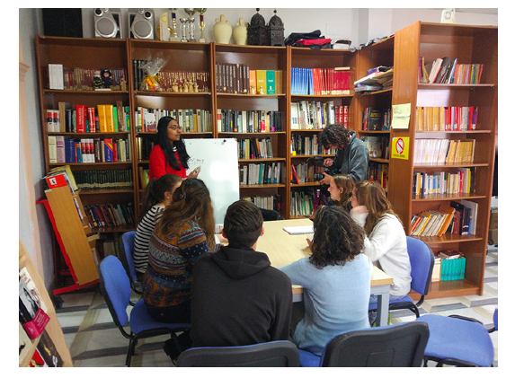
Biblioteca de acogida= Hosting library
Purchena, Almería

Slide 17
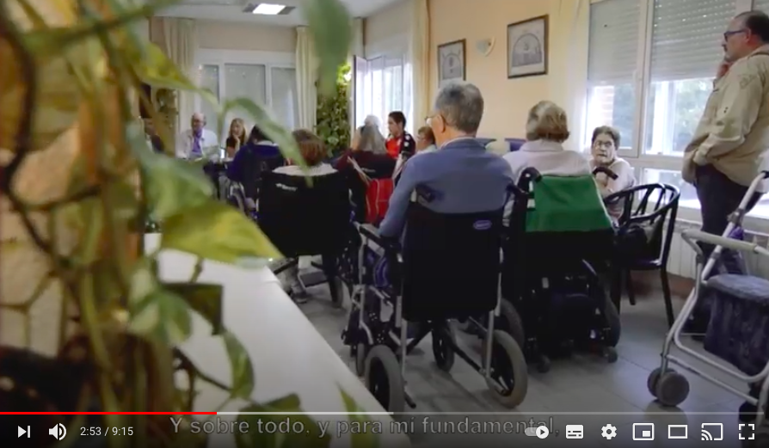
Te haré de la vida un cuento = I'll make life a tale for you
Soto del Real, Madrid

Slide 18
The recognition
The seal

Slide 19
One Award
Annual "Public Library and Social Engagement" Award
From Social Library Foundation
6 editions
Social library projects map
Inclusive and Social project tools for libraries

Slide 20
One Seal
Annual seal (one for library type)
4 editions
Seal map (with SDGs perspective)

Slide 21
Thoughts or confessions
(not conclusions)

Slide 22
In confidence
Good practices and micropolicies
Professional Commitment and volunteering
Collaborations and Partnership
Data, data, data
Impact studies

Slide 23
Thanks!
Alicia Sellés Carot
@aliciaselles
@FESABID

